Slide 1
Introduction & initialization of JavaScript
By Faheem Ahmed

Slide 2
JavaScript
JavaScript is a scripting language that allows building dynamic Web pages by ensuring maximum user interactivity.
JavaScript language is an object-based language, which means that it provides objects for specifying functionalities.
In a scripting language, an object has a unique identity, state, and behavior.
The object stores its identity and state in fields (also called variables) and exposes its behavior through functions (actions).
Notes:
In real life, an object is a visible entity such as a car or a table having some characteristics and capable of performing certain actions.

Slide 3

JavaScript
Real World Object:
State
Name, Model, Color
Behavior
Start(), accelerate() Identity
Registration #

Slide 4
Scripting
Scripting refers to a series of commands that are interpreted and executed sequentially and immediately on occurrence of an event.
This event is an action generated by a user while interacting with a Web page.
A scripting language refers to a set of instructions that provides some functionality when the user interacts with a Web page.
Scripting languages are often embedded in the HTML pages to change the behavior of the Web pages according to the user’s requirements.

Slide 5
Scripting
Scripting
Client-side Scripting
Server-side Scripting
Notes:
Client side:
Refers to a script being executed on the client’s machine by the browser.
Server side:
Refers to a script being executed on a Web server to generate dynamic HTML pages.

Slide 6
Client-Side JavaScript
A Client-side JavaScript is executed by the browser on the user’s machine.
A client-side script might contain instructions for the browser to handle user interactivity.
These instructions might be to change the look or content of the Web page based on the user inputs.
Examples include displaying a welcome page with the user name, displaying date and time, validating that the required user details are filled, and so on.

Slide 7
Client-Side JavaScript
Following figure displays the output of a Client-Side JavaScript:

Slide 8
Server-Side JavaScript
A Server-side JavaScript is executed by the Web server when an HTML page is requested by a user and the output is displayed by the browser.
A server-side JavaScript can interact with the database, fetch the required information specific to the user, and display it to the user.
Server-side scripting fulfills the goal of providing dynamic content in Web pages.

Slide 9
Server-Side JavaScript
Following figure displays the output of a Server-Side JavaScript:

Slide 10
Scripting initialze
HTML DOCUMENT
Document Header
<script>
script statements
</script>
Document Body
<script>
script statements
</script>

Slide 11
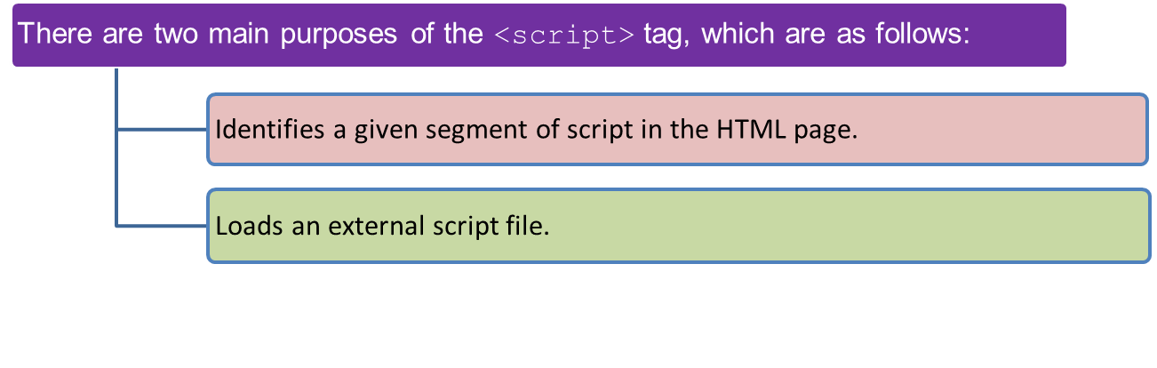
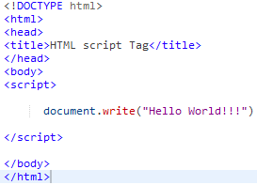

<script> tag
The HTML <script> tag is used for declaring a script (such as JavaScript) within your HTML document.
The <script> tag defines a script for an HTML page to make them interactive.
Output

Slide 12
External JavaScript Advantages
External JavaScript Advantages
Placing JavaScripts in external files has some advantages:
It separates HTML and code
It makes HTML and JavaScript easier to read and maintain
Cached JavaScript files can speed up page loads

Slide 13
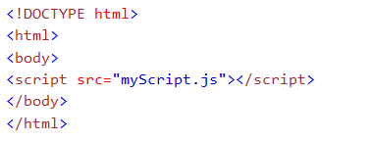
External JavaScript
Scripts can also be placed in external files.
External scripts are practical when the same code is used in many different web pages.
JavaScript files have the file extension .js.
To use an external script, put the name of the script file in the src (source) attribute of the <script> tag:

Slide 14
JavaScript Syntax
JavaScript Programs
A computer program is a list of "instructions" to be "executed" by the computer.
In a programming language, these program instructions are called statements.
JavaScript is a programming language.
JavaScript statements are separated by semicolons.
JavaScript Statements
JavaScript statements are composed of:
Values, Operators, Expressions, Keywords, and Comments.
JavaScript Variables
In a programming language, variables are used to store data values.
JavaScript uses the var keyword to define variables.
An equal sign is used to assign values to variables.
In this example, x is defined as a variable. Then, x is assigned (given) the value 6:
JavaScript Operators
JavaScript uses an assignment operator ( = ) to assign values to variables:

Slide 15
JavaScript Expressions
An expression is a combination of values, variables, and operators, which computes to a value.
The computation is called an evaluation.
JavaScript is Case Sensitive
All JavaScript identifiers are case sensitive.
The variables lastName and lastname, are two different variables.

Slide 16
JavaScript Variables
Variables can be thought of as named containers. You can place data into these containers and then refer to the data simply by naming the container.
Before you use a variable in a JavaScript program, you must declare it. Variables are declared with the var keyword.
Syntax:
^{where,}
var: Is the keyword in JavaScript.
variableName: Is a valid variable name.
^{var <variableName>;}

Slide 17
Declaring Variables 1-4
Declaring a variable refers to creating a variable by specifying the variable name.
For example, one can create a variable named to store the name of a student.
In JavaScript,
the var keyword is used to create a variable by allocating memory to it.
a keyword is a reserved word that holds a special meaning.
the variable can be initialized at the time of creating the variable or later.
initialization refers to the task of assigning a value to a variable.
once the variable is initialized, you can change the value of a variable as required.
variables allow keeping track of data during the execution of the script.
while referring to a variable, you are referring to the value of that variable.
one can declare and initialize multiple variables in a single statement.

Slide 18
JavaScript Variables
The Code Snippet declares two variables namely, stdID and stdName and assign values to them.
^{var stdID;}
^{var stdName;}
^{stdID = 50;}
^{stdName = “David Fernando”;}
The Code Snippet demonstrates how to declare and initialize multiple variables in a single statement in JavaScript:
^{var stdName = David,} ^{stdAge = 15;}

Slide 19
Variable Naming Rules
JavaScript is a case-sensitive language.
The variables X and x are treated as two different variables.
JavaScript consists of certain rules for naming a variable as follows:
In JavaScript, a variable name
can consist of digits, underscore, and alphabets.
must begin with a letter or the underscore character.
cannot begin with a number and cannot contain any punctuation marks.
cannot contain any kind of special characters such as +, *, %, and so on.
cannot contain spaces.
cannot be a JavaScript keyword.

Slide 20
Data Types in JavaScript 2-3
^{Following} table lists the primitive data types.
^{Primitive Data Type} | ^{Description}
^{boolean} | Contains only two values namely, true or false
^{null} | Contains only one value namely, null. A variable of this value specifies that the variable has no value. This null value is a keyword and it is not the same as the value, zero
^{number} | Contains positive and negative numbers and numbers with decimal point. Some of the valid examples include 6, 7.5, -8, 7.5e-3, and so on
^{string} | Contains alphanumeric characters in single or double quotation marks. The single quotes is used to represent a string, which itself consists of quotation marks. A set of quotes without any characters within it is known as the null string

Slide 21
Data Types in JavaScript 3-3
COMPOSITE DATA TYPES
A composite data type stores a collection of multiple related values, unlike primitive data types.
In JavaScript, all composite data types are treated as objects.
A composite data type can be either predefined or user-defined in JavaScript.
Following table lists the composite data types.
^{Composite Data Type} | ^{Description}
^{Objects} | Refers to a collection of properties and functions. Properties specify the characteristics and functions determine the behavior of a JavaScript object
^{Functions} | Refers to a collection of statements, which are instructions to achieve a specific task
^{Arrays} | Refers to a collection of values stored in adjacent memory locations

Slide 22
Data Types in JavaScript
To identify the type of data that can be stored in a variable, JavaScript provides different data types.
Data types in JavaScript are classified into two broad categories:
Primitive Data types:
contain only a single value such as a number or a string.
Boolean
var x = true;
Null
var person = null;
Number
var length = 16;
String
var lastName = “xyz";

Slide 23
Data Types in JavaScript
Composite Data types:
Stores a collection of multiple related values.
In JavaScript all composite data types are treated as objects.
Objects
var x = {firstName:“abc", lastName:“xyz"};
Functions
function myFunction(){
alert("Hello World");
}
Arrays
var cars = [“Corolla", “Mercedes", "BMW"];

Slide 24
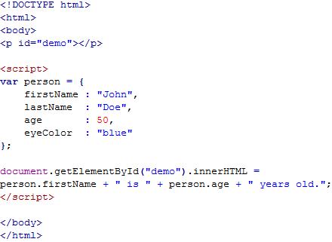

Example
Output

Slide 25

The <script> Tag
In HTML, JavaScript code must be inserted between <script> and </script> tags.
JavaScript Functions and Events
A JavaScript function is a block of JavaScript code, that can be executed when "asked" for.
For example, a function can be executed when an event occurs, like when the user clicks a button.
You will learn much more about functions and events in later chapters.
JavaScript in <head> or <body>
You can place any number of scripts in an HTML document.
Scripts can be placed in the <body>, or in the <head> section of an HTML page, or in both.

Slide 26
JavaScript Display Possibilities
JavaScript can "display" data in different ways:
Writing into an alert box, using window.alert().
Writing into the HTML output using document.write().
Writing into an HTML element, using innerHTML.
Writing into the browser console, using console.log().

